Slide 1

RETAIL Store DATA ANALYSIS
By –Ramya P

Slide 2

PROBLEM STATEMENT
"The client, a leading retail company, wants to enhance its sales performance by understanding:”
customer purchasing patterns
optimizing inventory management
Product behaviour
Sales trends & seasonality etc..
So that will help the client make data-driven decisions to enhance sales and business performance.

Slide 3
OVERVIEW of data
Data Available From “Mar 2020” to “Dec 2023” for randomly selected 37 stores out of 535 stores.
Customer – 99,441 records
Orders – 1,12,650 records
OrderPayments – 1,03,886 records
OrderReview_Ratings – 1,00,000 records
ProductsInfo – 32,951 records
Stores Info – 535 records

Slide 4

Data DICTIONARY(1/3)
Field name | No:of Record | Key Variables | DataTypes | Description
Customer | Rows: 99,441 Columns: 4 | PK – Custid FK - Not Present | Int Varchar Varchar Varchar | Custid - Unique Customer ID customer_city - Location (city) of the customer customer_state - Location (State) of the customer Gender - Gender of the customer (M, F)
Orders | Rows: 1,12,650 Columns: 11 | PK – Not Present FK - Customer_id order_id product_id Delivered_StoreID | Integer Varchar Varchar Varchar Varchar TimeStamp Integer Float Float Integer Float | Customer_id - A unique identifier assigned to each customer order_id - A unique identifier for each order placed by a customer product_id - A unique identifier for the purchased product Channel - The mode of purchase, such as online, in-store, or phone delivery Delivered_StoreID - The unique identifier of the store where the order was delivered or picked up Bill_date_timestamp - The date and time when the order was billed Quantity - The number of units of the product purchased in the order Cost Per Unit - The cost of one unit of the product before discounts MRP - The Maximum Retail Price (MRP) of the product Discount – The discount amount applied to the order Total Amount - The final amount that should be paid by the customer after applying discounts

Slide 5
Data DICTIONARY(2/3)
Field name | No:of Record | Key Variables | DataTypes | Description
OrderPayments | Rows: 1,03,886 Columns: 3 | PK – Not Present FK - order_id | Varchar Varchar Float | order_id - A unique identifier for each order placed by a customer payment_type - The mode of payment used by the customer (e.g., credit card, debit card, UPI/cash, and voture) payment_value - The total amount paid by the customer for the order
OrderReview_Ratings | Rows: 1,00,000 Columns: 2 | PK – Not Present FK - order_id | Varchar Tinyint | order_id - A unique identifier for each order placed by a customer Customer_Satisfaction_Score - A rating given by the customer to express their satisfaction with the order, typically on a scale (1 to 5)

Slide 6
Data DICTIONARY(3/3)
Field name | No:of Record | Key Variables | DataTypes | Description
ProductsInfo | Rows: 32,951 Columns: 9 | PK – product_id FK - Not Present | Varchar Varchar Integer Integer Integer Integer Integer Integer Integer | product_id - Unique product ID Category - The category or type of product (Electronics, Clothing, Furniture, etc.) product_name_length - The length (number of characters) of the product name product_description_length - The length (number of characters) of the product description product_photos_qty - The No:of photos for a product product_weight_g - The weight of the product in grams product_length_cm - The length of the product in centimeters product_height_cm - The height of the product in centimeters product_width_cm - The width of the product in centimeters
Stores Info | Rows: 535 Columns: 4 | PK – StoreID FK - Not Present | Varchar Varchar Varchar Varchar | StoreID - Unique store ID seller_city - Location (city) of the store seller_state - Location (state) of the store Region - Region (North, Sount, East, West)

Slide 7
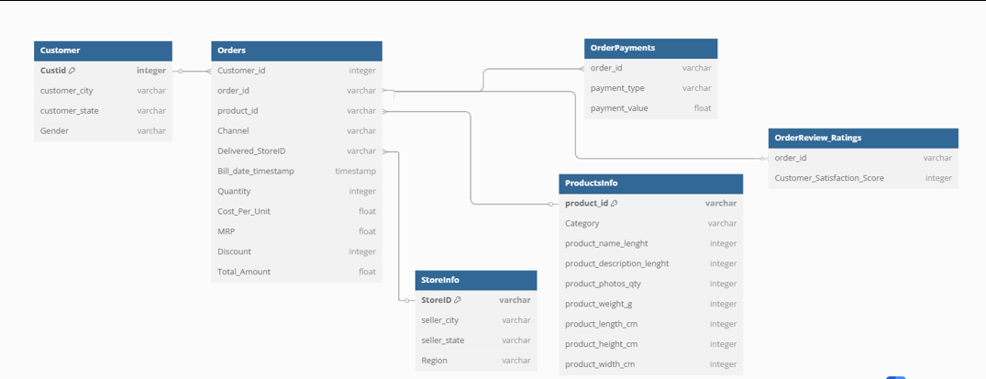
ENTITY RELATIONSHIP DIAGRAM

Slide 8
Data Discrepancies (1/10)
Orders Table:
1. Miss Match of Total Amount in orders table and Payment Value in OrderPayments table
Orders Table
OrderPayments Table
Observation: Round off the value to the nearest ten’s place and match with the Total_Amount in Orders Table to the Payment_value in the OrderPayments Table
Example: ROUND(141.9,-1) → 140
ROUND(142.88,-1) → 140

Slide 9

Data Discrepancies (2/10)
Orders Table:
2. For the same customer_id, order_id and product_id the associated Quantity was different
OrderPayments Table
Observation: Round off the value and map with the order_id and Total_Amount in Orders Table to the order_id and Payment_value in the OrderPayments Table.

Slide 10





Data Discrepancies (3/10)
Orders Table:
3. For channel – ‘instore’ at the same timestamp, customer_id, order_id the delivered_StoreID’s are different – 1007 records
OrderPayments Table
Observation: Sum up the MRP in Orders Table to match with the Payment_value in the OrderPayments Table.
Since there is no enough data to pick the correct storeID and which storeID to pick and why?

Slide 11

Data Discrepancies (4/10)
Orders Table:
4. For the same order_id and customer_id there are different time stamps – 334 records were found
OrderPayments Table
Observation : Sum up the MRP in Orders Table to match with the Payment_value in the OrderPayments Table.
Since there is no enough data to pick the correct storeID and which storeID to pick and why?

Slide 12


Data Discrepancies (5/10)
Orders Table:
5. There are multiple Customer_id values associated with the same order_id
OrderPayments Table
Observation: Map order_id and Total_Amount in the Orders table with the payment_value in the OrderPayments Table and order_id

Slide 13
Data Discrepancies (6/10)
Orders Table:
6. order_id 'bfbd0f9bdef84302105ad712db648a6c' is present in orders table but not present in OrderPayments table
7. Not in the mentioned TimeStamp [‘Sep 2021’ to ‘Oct 2023’]
8. Bill_date_timestamp – Wrong Data Type [Text & Date format]

Slide 14
Data Discrepancies (7/10)
ProductsInfo [Product_ID is PK]
1. There are #N/A and Blanks in certain columns
Solution: Replace the #N/A with others and leave the blanks because the information is not used

Slide 15


Data Discrepancies (8/1)
Store Info [Store_ID is PK]
1. Duplicate row is present of StoreID – ‘ST410’
Solution: Delete the record which is duplicated

Slide 16
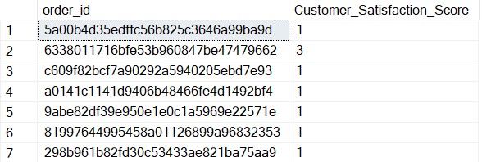

Data Discrepancies (9/10)
OrderReview_Ratings
1. Order_ID which are present in OrderReview_Ratings Table are not present in Orders Table – 778 records
2. Same Order_ID has multiple Customer_Satisfaction_Score // This can be solved by taking the aggregate of orders and average of Customer_Satisfaction_Score – 555 records

Slide 17
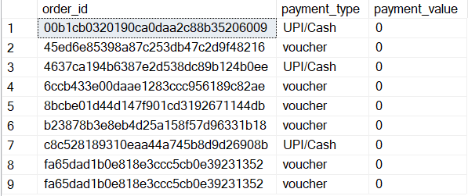
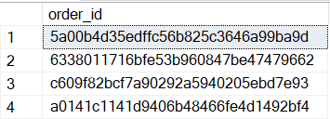
Data Discrepancies (10/10)
OrderPayments
1. For certain orders the Payment_Value is 0 – 9 records were found
2. Some order_id which are present in orderPayments table are not present in orders table – 775 records were found

Slide 18

THANK YOU

